Slide 1

Classification –Prediction of Bank Churn Customer
mINi pROject

Slide 2
Business Objective
●Build a predictive model to determine which customers are likely to churn (leave the bank)
●Given a set of customer record, determine the probabilities of churn for each customer

Slide 3
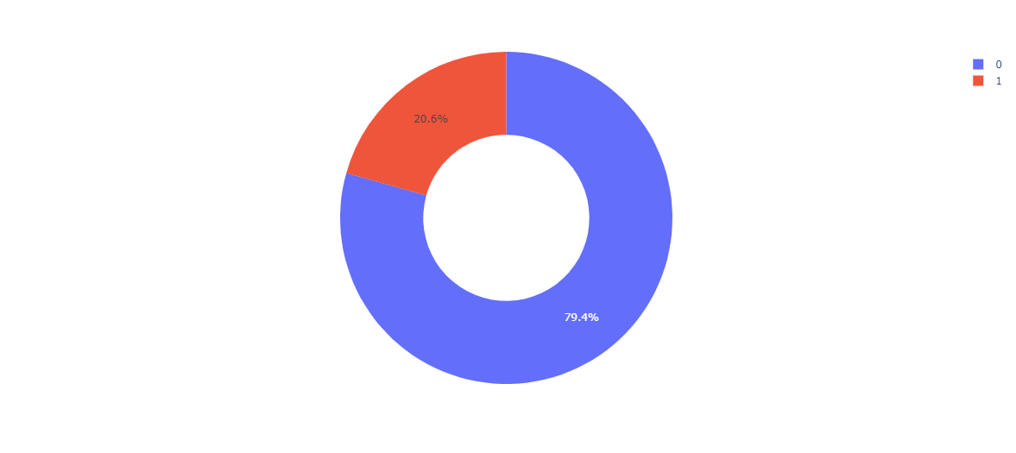
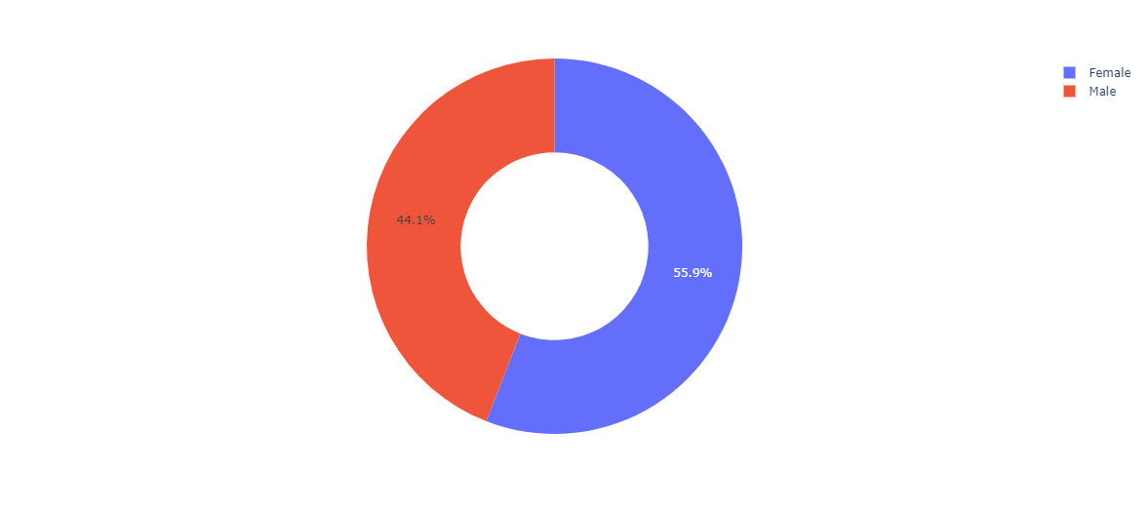
EXPLORATORY DATA ANALYSIS
20.6% People churn From the company
79.4% are in the company
Male are Churning More than Women

Slide 4
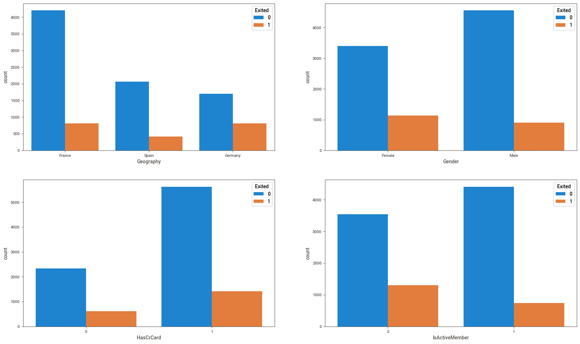
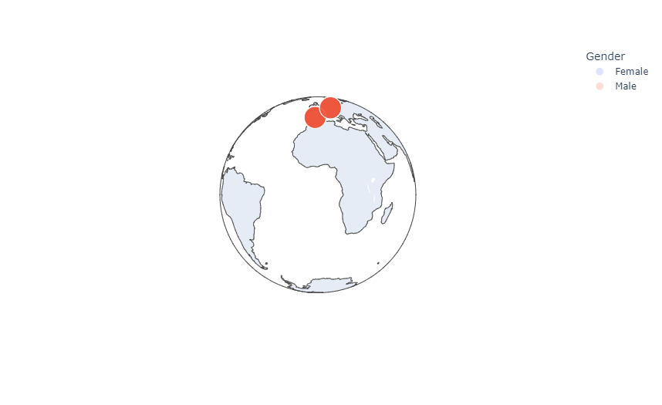
Majority of the data is from persons from France. And churn rate of France is also Higher
The proportion of female customers churning is also greater than that of male customers
majority of the customers that churned are those with credit cards.
the inactive members have a greater churn

Slide 5
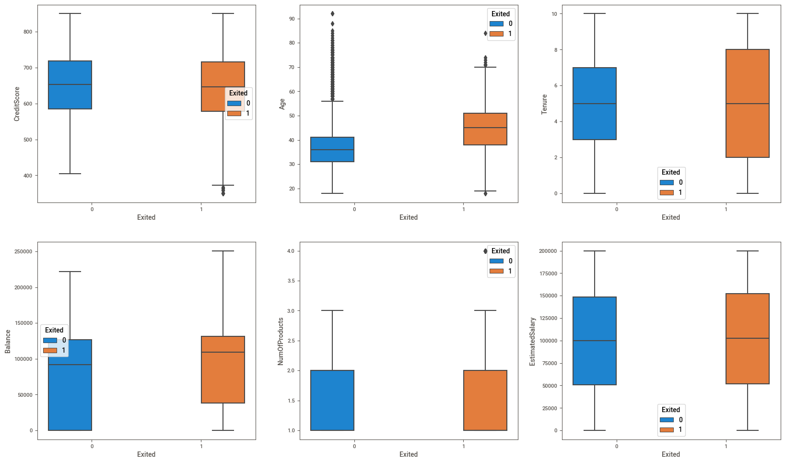
.older customers are churning at more than the younger ones

Slide 6

TECHNICAL DETAILS

Slide 7
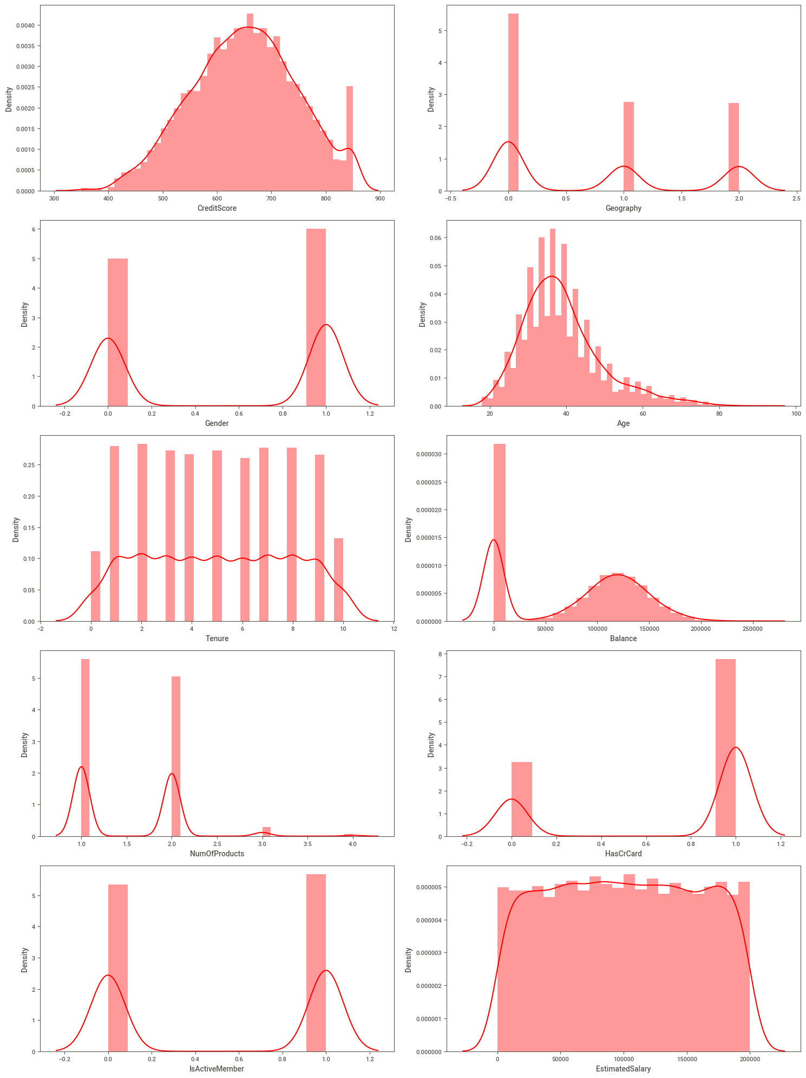
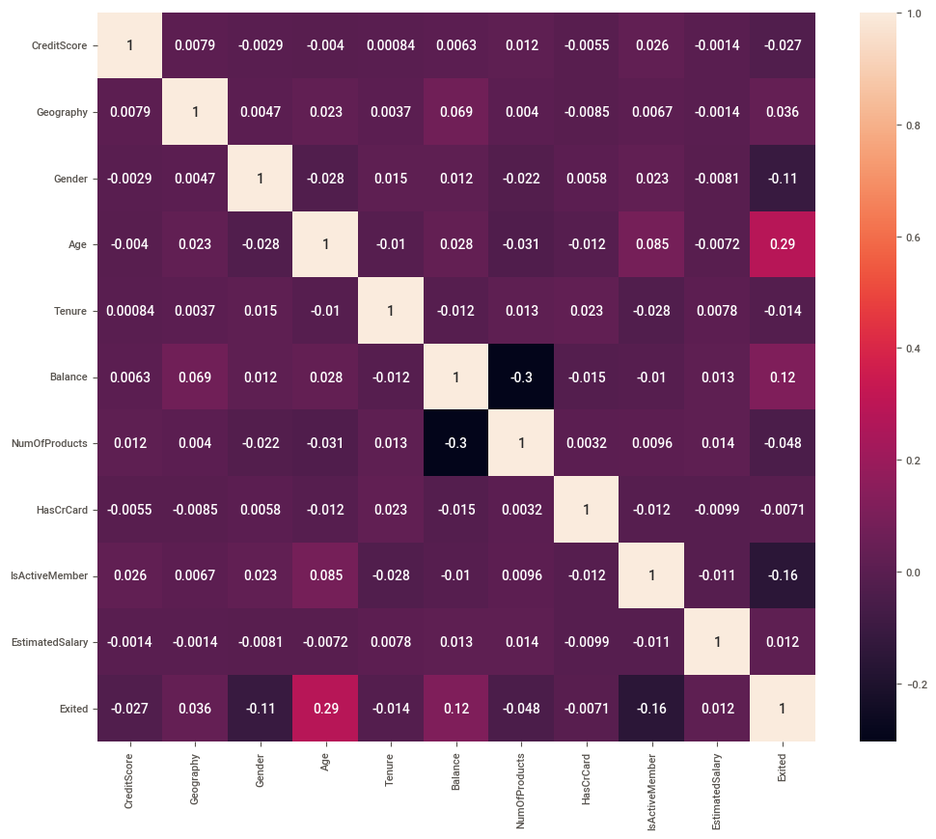
DATA SET CONTAIN OUTLIERS
Most of The features Contain OUTLIERS
Some of the feature are positively Skewed
Features are not much correlated to each other

Slide 8
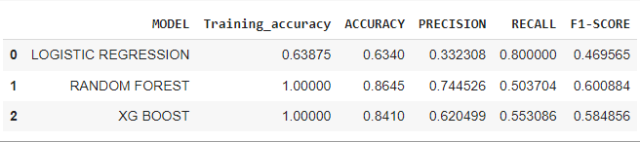
FINDING BEST ALGORITHM
Data Frame for Best Algorithm
Random Forest Performing Best than others models as Data is Highly imbalance After hyperparameter tuning
Data is Highly Imbalance so I am comparing all the model from F1 score
Random Forest Perform better than others models
Error are also less comparision to other Model
RANDOM FOREST is BOOTSRAP AGGREGATION (BAGGING ) ALGORITHM which uses number of DECISION TREE
Planted parallely and Reduce Overfitting in the model
It convert low Bais and High Variance into Low Bais and Low Variance

Slide 9
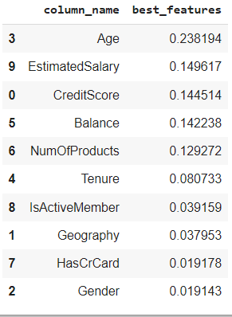
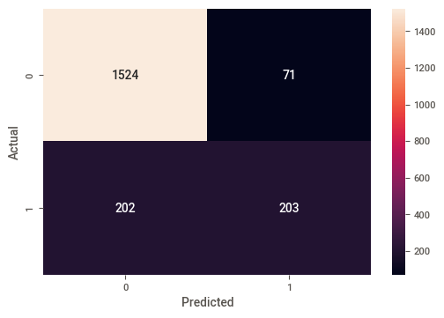
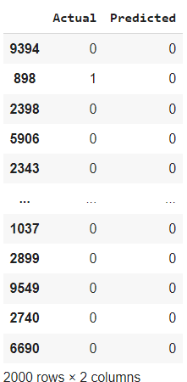
BEST FEATURES FROM RANDOM FOREST
BEST FEATURES Confusion Matrix
Actual And Predicted Value

Slide 10
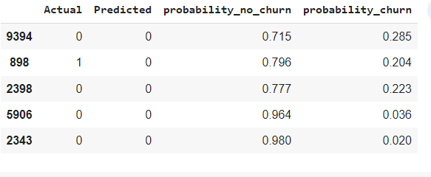
Given a set of customer record, determine the probabilities of churn for each customer
Probability of people who have churn and Probability of people who have not churn

Slide 11
CONCLUSION
Majority of People are from France and They have highest Churning then other Country
Female Customer are churning is high
the inactive members have a greater churn. overall proportion of inactive members is high suggesting that the bank may need a program implemented to turn this group to active customers as this will definitely churn and have a negative Impact on Bank
As we can See from box plot older customers are churning at more than the younger ones bank must review their target customers and approach to younger ones instead to aged group person or they come up with some program or implement some scheme that older customers will not churn

